Slide 1
Adjusting the Regional Haze Glide path using Monitoring and Modeling Data
Trends
Natural Conditions
International Anthropogenic Contributions

Slide 2
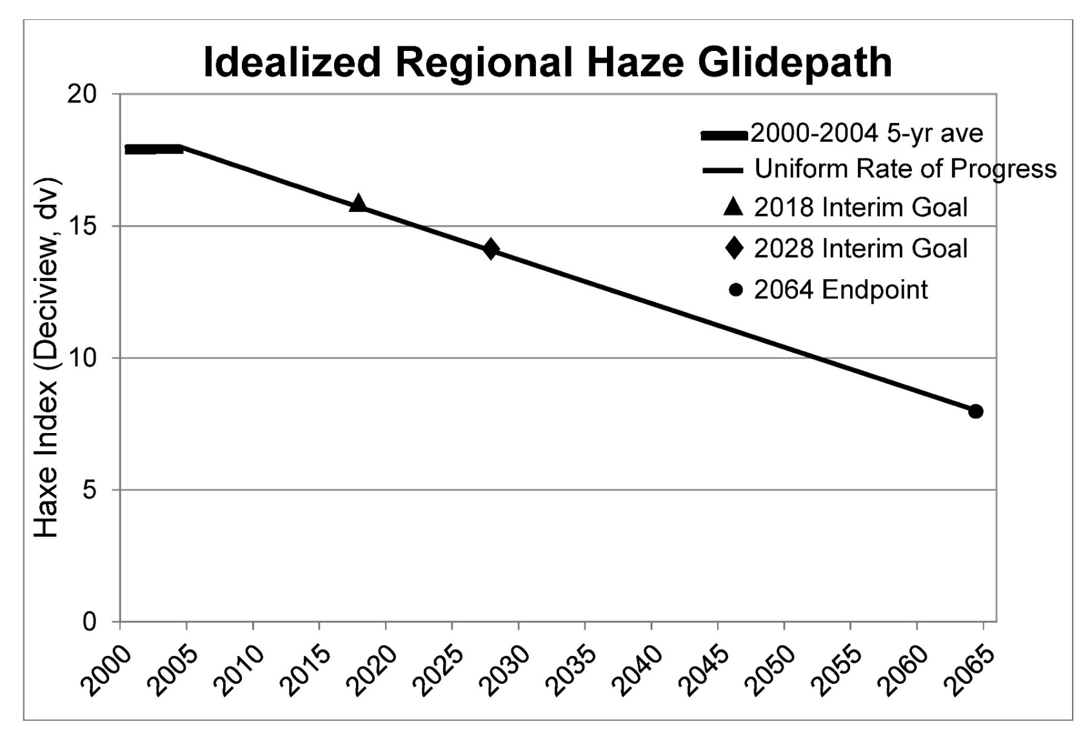
Regional Haze Regulatory Construct
Uniform Rate of Progress (URP) glidepath is based on monitoring data and assumed natural conditions in 2064.

Slide 3
Regional Haze Regulatory Construct: Round 1
Photochemical grid models were used to define 2018 Reasonable Progress Goals (RPG) for haziest days.
2018 Modeled RPG

Slide 4
Regional Haze Regulatory Construct
On haziest days, monitoring data for 2000-2016 can be highly variable due to contributions from natural sources such as fire or dust. Revising the visibility tracking metric from haziest to most impaired days attempted to remove the influence of episodic extreme natural events on the URP.

Slide 5
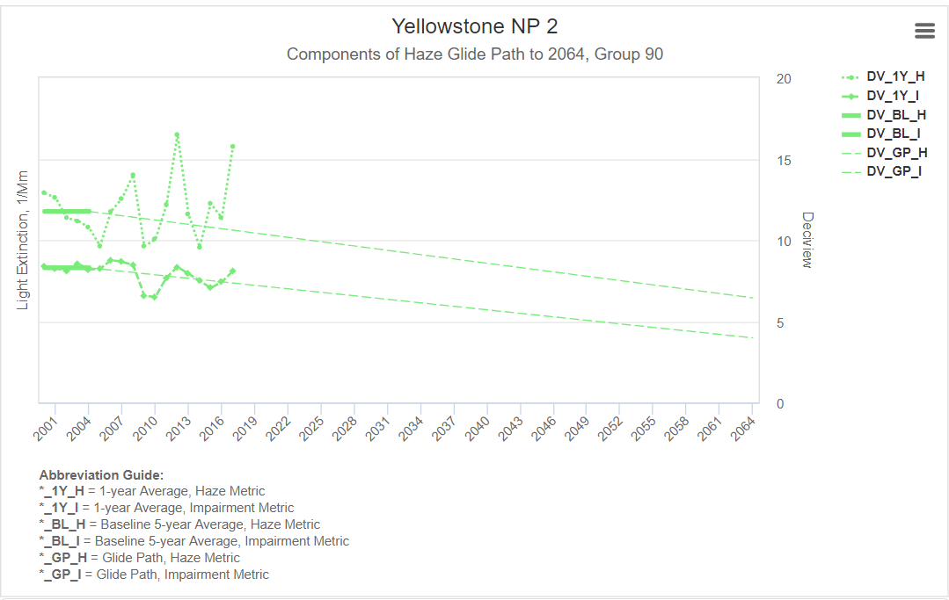
Glide path graphics are illustrated on Technical Support System 2
DRAFT
http://views.cira.colostate.edu/tssv2/

Slide 6
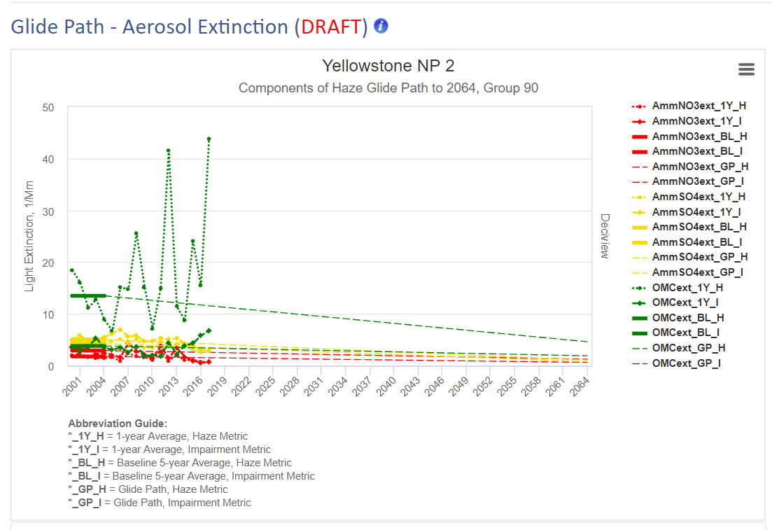
Specific graphics still to be refined……
DRAFT
http://views.cira.colostate.edu/tssv2/

Slide 7
2018 EPA guidance for Uniform Rate of Progress (URP)
Determine URP using most impaired days as defined by EPA assumptions for natural vs anthropogenic contributions to IMPROVE monitoring data
Starting point is 2000 – 2004 baseline
Average natural contributions on most impaired days for 2000 – 2014 are used for 2064 endpoint
Uniform Rate of Progress is straight line between baseline and 2064 endpoint
Photochemical models are used to project visibility progress by 2028
URP Glidepath can be adjusted using scientifically valid data and methods and in consultation with EPA regions
Today’s objective is to begin dialog for WRAP technical evaluation of methods to adjust URP

Slide 8
Regional Haze Regulatory Construct: Round 2
URP is based on most impaired days. If EPA method using monitoring data and model source apportionment don’t agree on natural vs anthropogenic contributions to aerosol light extinction, then modeled RPG may not agree with URP.
2028 modeled RPG

Slide 9
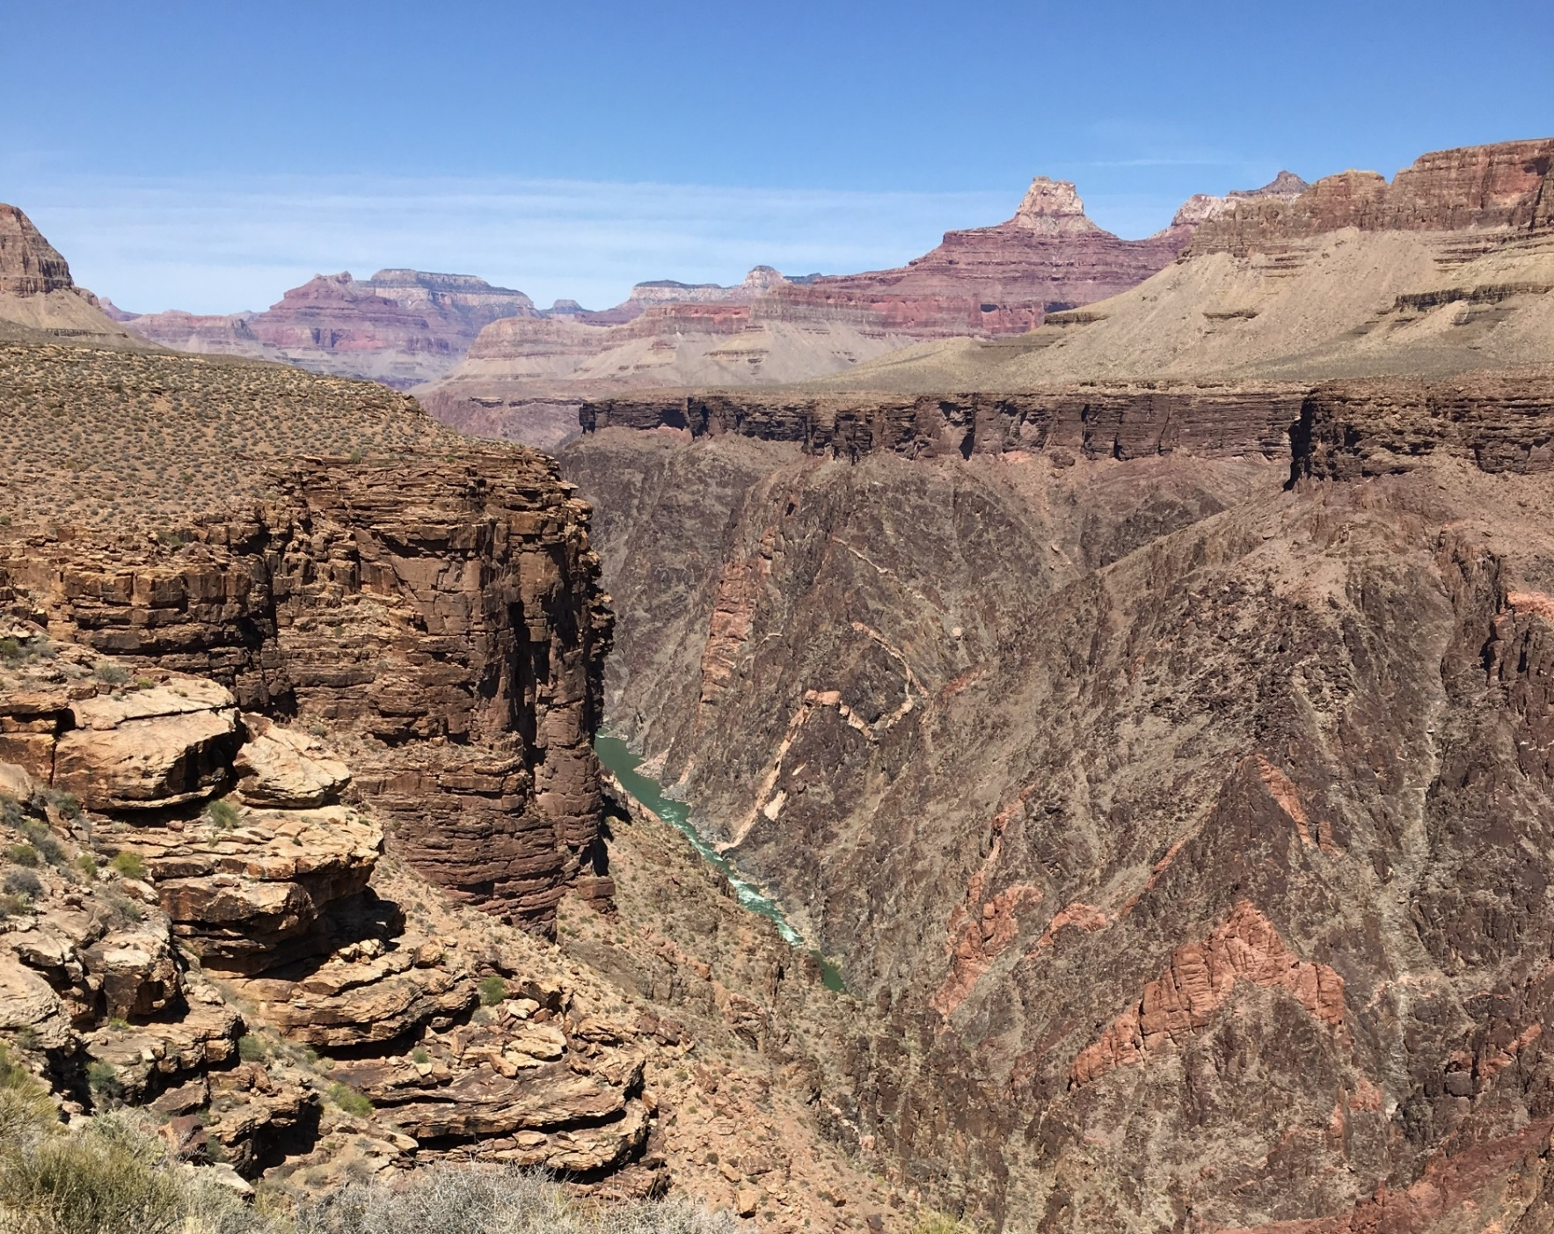
April 13, 2018 Webinar (http://www.wrapair2.org/RHPWG.aspx)

Slide 10
Question 1: How to resolve the disparity between most impaired days identified by monitoring data versus modeling data?
Use days selected by EPA method or days identified by model as most impaired days?
Uncertainty in natural vs anthropogenic contributions to monitoring data using EPA method
Uncertainty in model performance and in CAMx-PSAT source apportionment
Uncertainty in international emissions and global models that are used as boundary conditions for regional (North American) model
Hold off on decision until review model performance

Slide 11
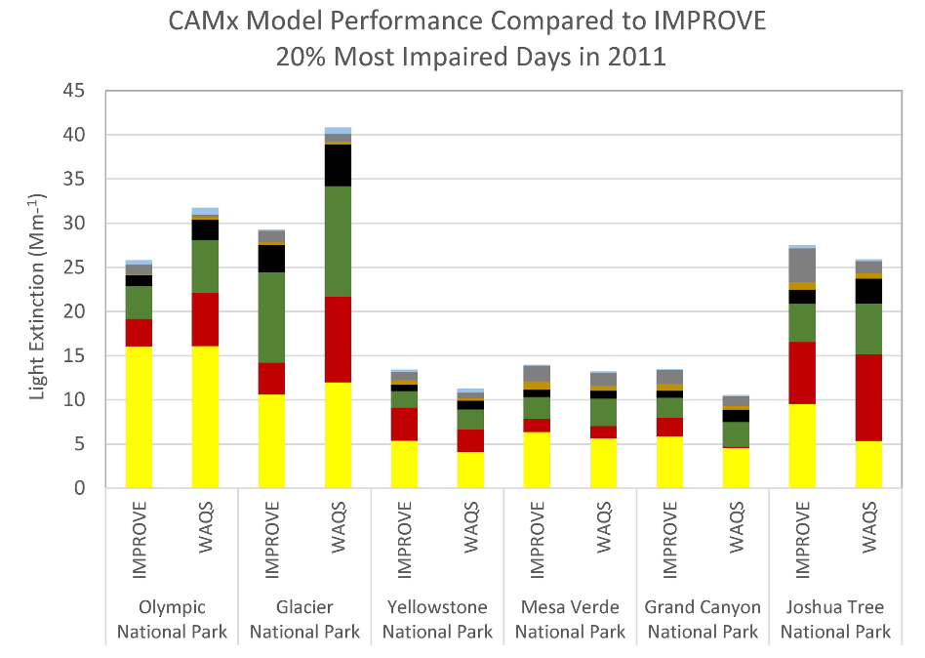
Brewer, Tonnesen, Morris, Moore, Nopmongcol, and Miller, AWMA 2019

Slide 12
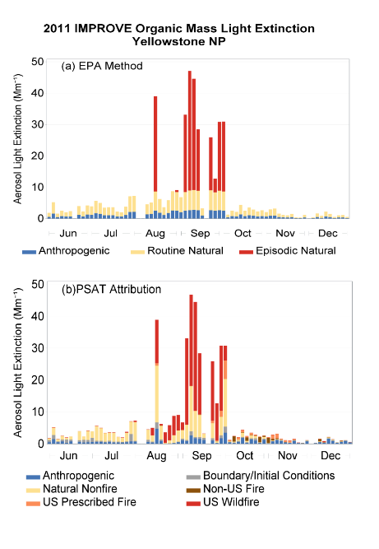
Question 1a: Do EPA method and CAMx-PSAT agree on contributions from wildfire?
Yes, for most sites, for organic carbon mass attributed to wildfire or prescribed fire.
For sites with high fire frequency, 95% may not adequately capture episodic contributions.
CAMx poor performance for wind-blown dust; comparison to EPA method was inconclusive.

Slide 13
Question 1b: Do EPA method and CAMx-PSAT agree on source contributions to ammonium sulfate?
EPA method assumes most SO4 is anthropogenic, CAMx-PSAT assigns more SO4 to international than US anthropogenic

Slide 14
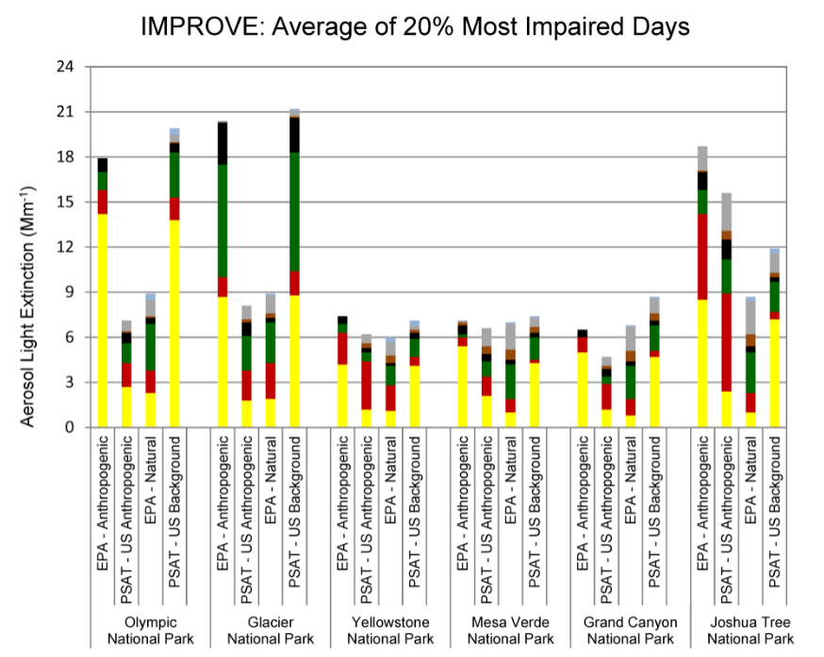
Question 1c: Do EPA method and CAMx-PSAT agree on source contributions to ammonium nitrate?
CAMx-PSAT assigns most NO3 to U.S. anthropogenic; EPA method assigns more NO3 to natural than does CAMx-PSAT

Slide 15
Question 1: How resolve disparity in source characterization between EPA method and model?
Dynamic modeling can apply 2014 meteorology with 2002, 2014, and 2028 emissions to calculate visibility response to emissions changes.
2028 modeled RPG

Slide 16
Question 2: Are average 2000-2014 Natural Conditions (NC) on most impaired days a good estimate for 2064 NC endpoint?
In future, as anthropogenic emissions are reduced, natural conditions will contribute larger fraction of total extinction
Current analyses: What are spatial and temporal trends in natural conditions on most impaired days for the 2000-2017 record?
Daily and Annual split of natural vs anthropogenic contributions per IMPROVE/EPA
Model sensitivity analyses can project response to changes in current conditions (e.g. double wildfire or prescribed fire)
Range in natural conditions in 2028

Slide 17
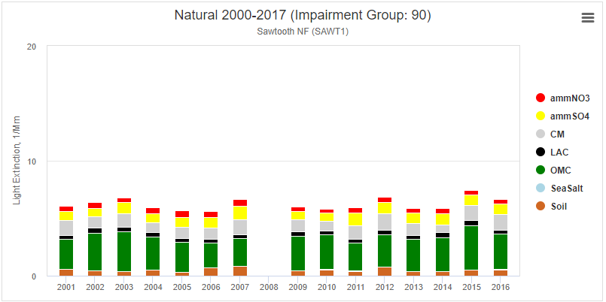

Slide 18
Question 3: How account for international emissions or prescribed fire to adjust URP glidepath?
International: EPRI is currently supporting evaluation of international contributions using GEOS Chem global model for 2016 and 2028.
Zero out sensitivity runs to define international anthropogenic or U.S. anthropogenic contributions
Wildfire or prescribed fire: Model sensitivities will evaluate impact of varying wildfire or prescribed fire in 2028.
WRAP anticipates using above weight of evidence to adjust glide path in 2028 rather than applying 2028 results to adjust 2064 endpoint

Slide 19
Question 3: How to account for international emissions or prescribed fire to adjust URP glidepath?
Key objective is to evaluate cumulative progress in reducing U.S. contributions to anthropogenic visibility impairment
Uncertain if photochemical model estimates of U.S. impairment will be the same as EPA statistical model applied to IMPROVE data.
To compare these two approaches, we need photochemical model estimates of U.S. impairment in 2002 and 2014. Use these result to compare the photochemical model URP to the statistical model URP.
If photochemical model and statistical model estimates of U.S., impairment, prescribed fire and natural conditions differ, we can include alternative WOE approaches to assess progress:
Default EPA approach: compare photochemical model RPG from 2014 to 2028 to statistical model of URP from 2002 to 2028.
Alternate approaches: Compare photochemical model RPG from 2002 to 2028 to photochemical model URP from 2002 to 2028.
Evaluate RPG on photochemical model most impaired days.

Slide 20
Next Steps?
Subcommittee design questions and analyses
Contractor support to implement and report to Subcommittees

Slide 21
